Slide 1
A survey on Detection of
covid -19 using Deep Learning
CMPE - 258 (Deep Learning) Short Story

Slide 2
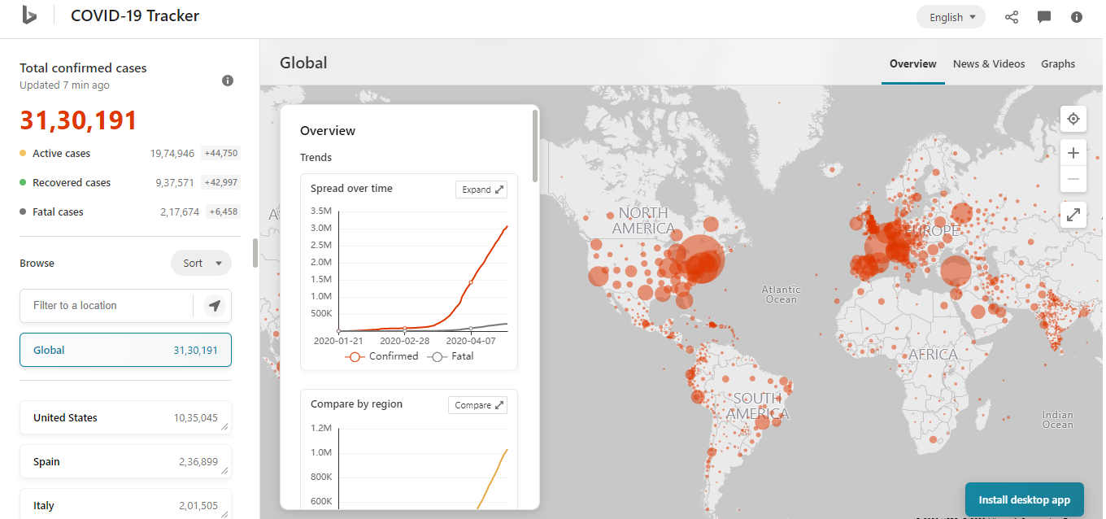
Issue
As of 29th April, there are a total of 31,30,191 cases with 2,17,674 deaths in more than 200 countries across the world.

Slide 3
So, in this particular scenario, one primary thing that needs to be done and has already started in the majority of the countries is Manual testing, so that the true situation can be understood and appropriate decisions can be taken.
But the drawbacks of manual testing include sparse availability of testing kits, costly and inefficient blood tests; a blood test takes around 5–6 hours to generate the result.
So, the idea is to overcome these circumstances using the Deep Learning technique for better and efficient treatment.
Since the disease is highly contagious therefore as early as we generate the results the fewer cases in the city that’s why we can use Convolution Neural Network to get our job done.

Slide 4
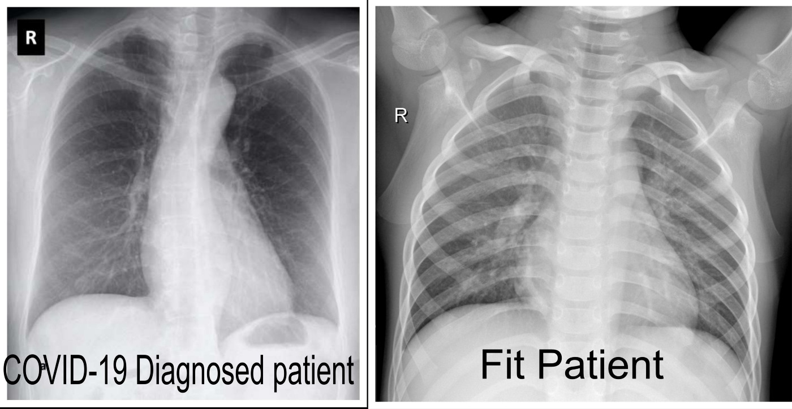

Slide 5
The problem is a binary classification problem where we classify Normal vs COVID-19 cases.
There are several pros and cons of using Deep Learning to tackle such kinds of situations:
Pros: More time saving; less expensive; easy to operate
Cons: Practically we need ~100% accuracy as we can’t wrongly identify the patients as it might lead to further spread of disease which is highly discouraged.

Slide 6
About dataset
The dataset consists of 349 images of chest CT-Scan from infected patients (labeled as pos, indicating “positive”) and 397 images from non-infected patients (labeled as neg, indicating “negative”).
The dataset is split into two categories, the training dataset, and the testing dataset.
The training dataset is used to train the deep learning model while the testing dataset is used to test the model’s performance after the training process.
The images from the training dataset are resized to a 1:1 ratio.
Then every one of the images is rotated 10° to the right, 10° to the left, 20° to the right, and 20° to the left, thus generating four new images.
This expands the dataset size to five times bigger before the addition of rotated images. The sum of images in the training dataset is 2950.
Meanwhile, the testing dataset images are only resized to a 1:1 ratio and are not rotated. The sum of images in the testing dataset is 74.

Slide 7
Methodology
The proposed model named FJCovNet is based on the DenseNet 121 pretrained model.
The application of transfer learning was used in building FJCovNet, which is excluding the top layer of the DenseNet 121 pretrained model.
This enables the pretrained model to work as a feature extractor but yet for classifying.
To enable the classifying function to our model, we add layers on top of the DenseNet121 layer, which works as the classification layers, to perform classification.
These layers are Batch Normalization, Global Average Pooling, Dense, and Dropout.

Slide 8
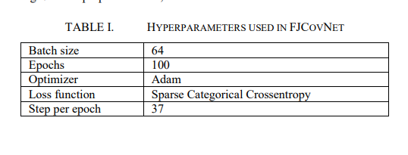

Slide 9
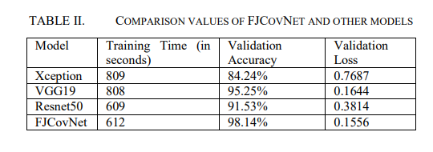
Results

Slide 10
conclusion
From the experiments we have conducted, it can be seen that FJCovNet achieved the highest validation with less time for training compared to Xception, VGG19, and Resnet50 with the same hyperparameter and dataset used for training and testing.
This shows that FJCovNet can help the COVID19 detection process quickly and accurately if applied in realtime computer applications.
FJCovNet can be built inside a computer application installed in Healthcare facilities.
Using API, users, in this case, the radiologist or medical personnel, can input the CT-scan images of suspected patients. The images are then inputted to FJCovNet, and the output is the prediction of whether the patient is positive or not.

Slide 11
Thank you!

